Slide 1
What are the risks of earthquakes in New jersey
By : Shannon Feeney

Slide 2
Past damage in New Jersey
New Jersey doesn't get many earthquakes, but it does get some. Fortunately most are small. A few
New Jersey earthquakes, as well as a few originating outside the state, have produced enough damage
to warrant the concern of planners and emergency managers.
Damage in New Jersey from earthquakes has been minor: items knocked off shelves, cracked plaster
and masonry and fallen chimneys. Perhaps because no one was standing under a chimney when it fell,
there are no recorded earthquake--related deaths in New Jersey. We will probably not be so fortunate
in the future.

Slide 3
Areas effected
Although the United States east of the Rocky Mountains has fewer
and generally smaller earthquakes than the West, at least two factors
increase the earthquake risk in New Jersey and the East. Due to
geologic differences, eastern earthquakes effect areas ten times larger
than western ones of the same magnitude. Also, the eastern United
States is more densely populated, and New Jersey is the most densely
populated state in the nation.

Slide 4
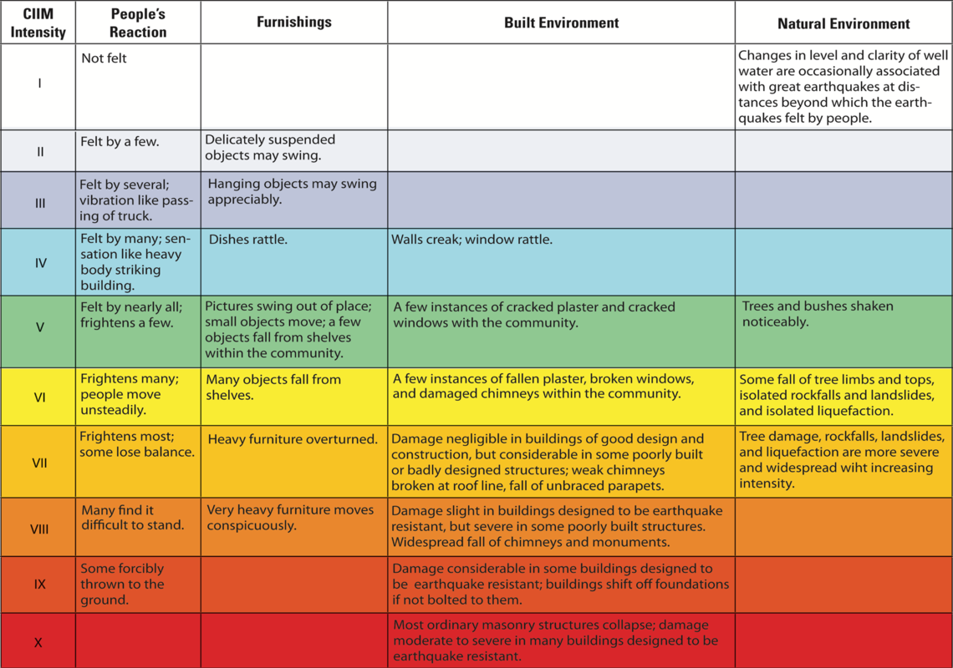
The Mercalli Scale
The Mercalli scale measures the intensity of an earthquake by quantifying the effects of an earthquake on the Earth's surface. Based on human reactions, natural objects and man-made structures, the Mercalli scale rates earthquakes on a scale of 1 to 12, with 1 denoting that nothing was felt and 12 denoting destruction. Invented in 1902 by Giuseppe Mercalli, the Mercalli scale isn't considered as scientific as the Richter scale. This is because the Mercalli scale relies on witnesses to report about the earthquake, so the quake's force is not defined in rigorous and objective standards, as the Richter scale provides.

Slide 5
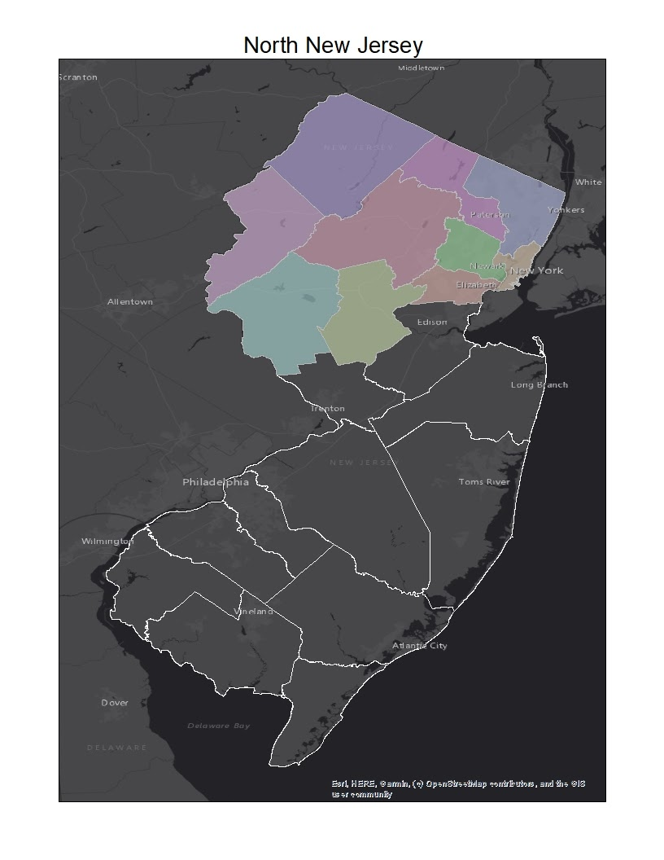
Location reference map
Counties
  Bergen
  Essex
  Hunterdon
  Passaic
  Sussex
  Union
  Warren
  Morris
  Hudson
  Somerset

Slide 6
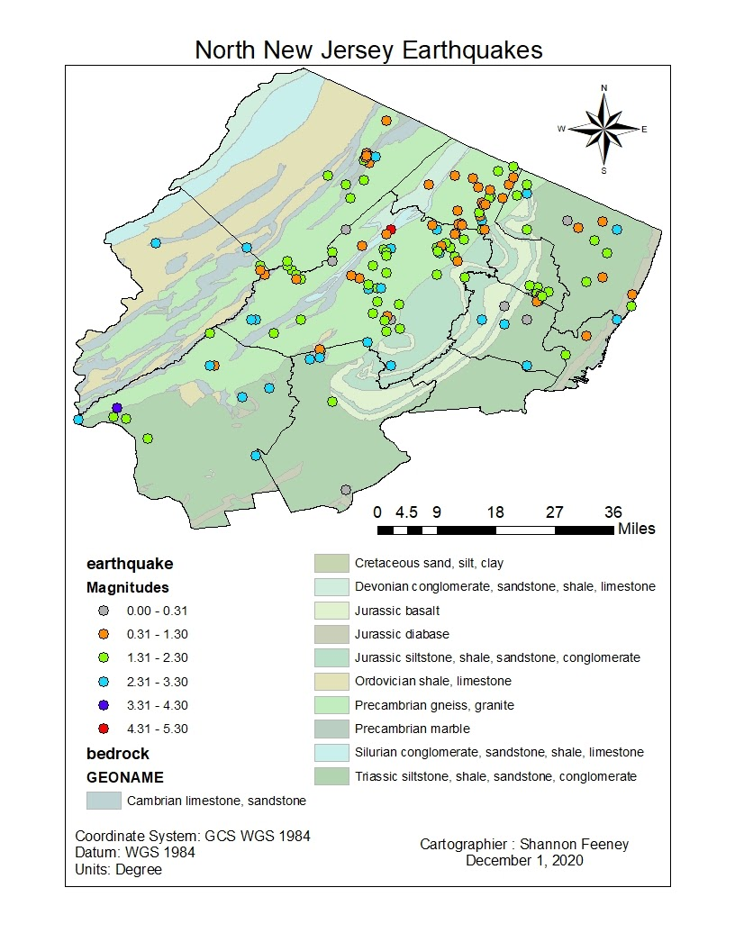
Bedrock map

Slide 7
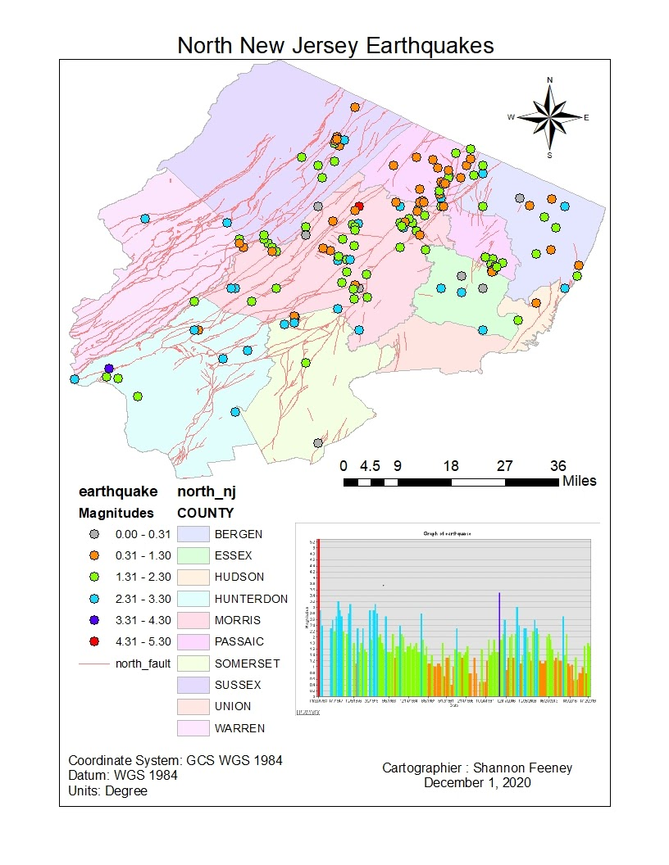
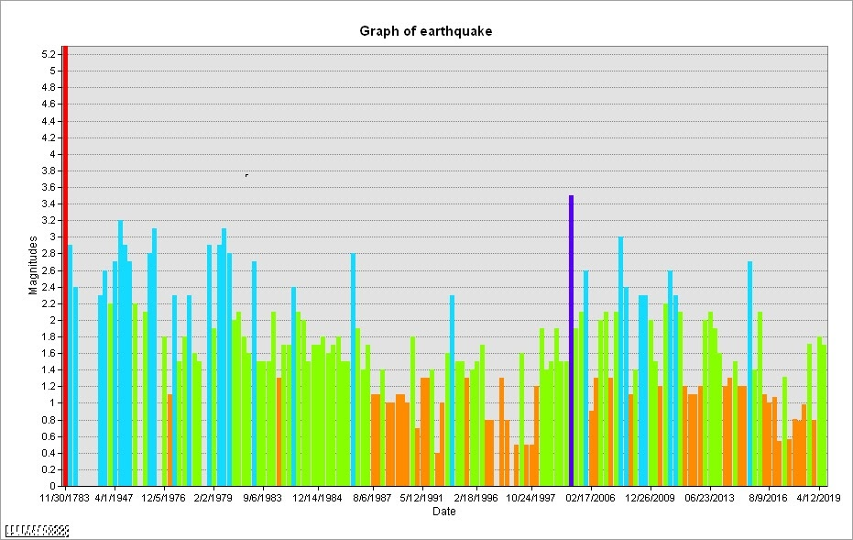
Fault line map

Slide 8
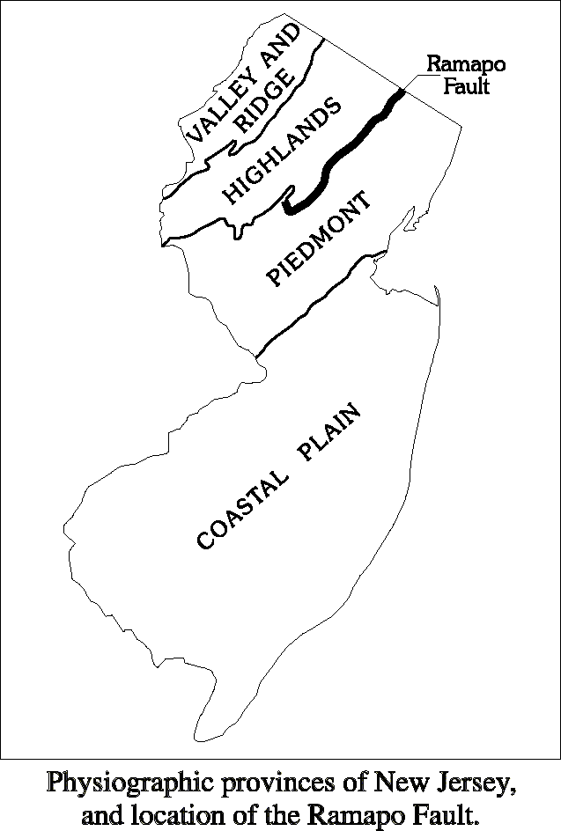
Faults and earthquakes
Although there are many faults in New Jersey, the Ramapo Fault, which
separates the Piedmont and Highlands Physiographic Provinces, is the best
known. In 1884 it was blamed for a damaging New York City earthquake
simply because it was the only large fault mapped at the time. Subsequent
investigations have shown the 1884 earthquake epicenter was actually
located in Brooklyn, New York, at least 25 miles from the Ramapo Fault.

Slide 9
Conclusion
Earthquakes felt in New Jersey are generally few and small. However, some earthquakes have produced damage in New Jersey. New Jersey’s seismic hazard is lower than many earthquake-prone parts of the United States. Across the state, seismic hazards are highest in northeastern New Jersey.

