Slide 1
Intro to gis:
Final project
By: Sean Fletcher

Slide 2
Research Question
Where is the best place for the city of Las Vegas to construct a baseball stadium for a new major league baseball (MLB) team?

Slide 3

Background
Fan of baseball
Rumors about a new MLB team
The attraction that Las Vegas brings
Golden Knights, Raiders, and ….Athletics?

Slide 4
More Background
Goal: To create a map in Las Vegas that shows the best possible areas for a baseball stadium to be built
Hypothesis: This stadium will be in the downtown area, near main roads, and will be in a place that is unaffected by the environment
Time Period: Present day to the future
Study Area: Local site located at the city of Las Vegas
Thesis: Downtown Las Vegas would provide the best possible location for a new MLB stadium and it would be close to a main road or highway that is not right by a river

Slide 5
Datasets
Location Reference Map | Thematic Map One | Thematic Map Two
tl_2019_us_state.shp | tl_2018_32_tract.shp | tl_2018_32_tract.shp
tl_2019_us_county.shp | tl_2019_32003_areawater.shp | tl_2019_32003_areawater.shp
 | tl_2019_32003_linearwater.shp | tl_2019_32003_linearwater.shp
 | tl_2019_32_prisecroads.shp | tl_2019_32_prisecroads.shp
Data came from two websites:
TIGER/Line Shapefiles (census.gov)
Datasets - Data.gov

Slide 6
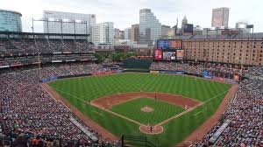
Datasets part 2
States – Nevada
Counties - Clark County
Zip codes – Population density for Clark county
Roads – Major roads in Clark County/Las Vegas
Rivers – Main rivers of Clark County/Las Vegas
Water Bodies/Lakes – Major lakes of Clark County/Las Vegas

Slide 7

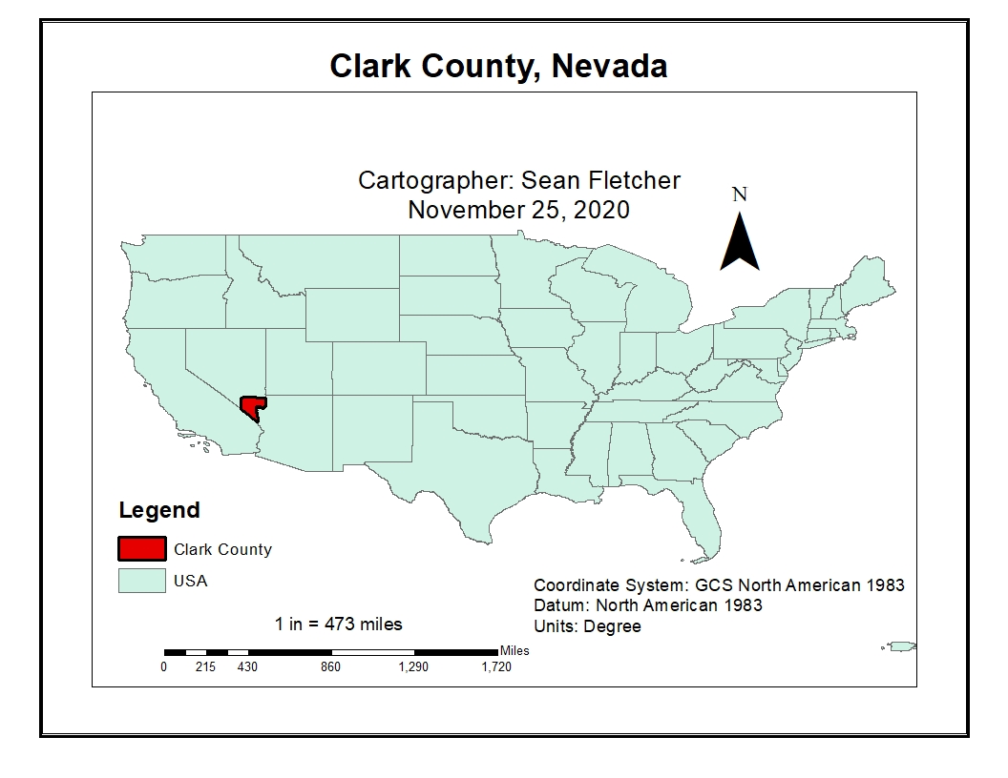
Location Reference map
Clark County, Nevada
Las Vegas
Population of 2.328 million people
Mostly a desert
Very little rain
Hot temperature
Colorado River

Slide 8
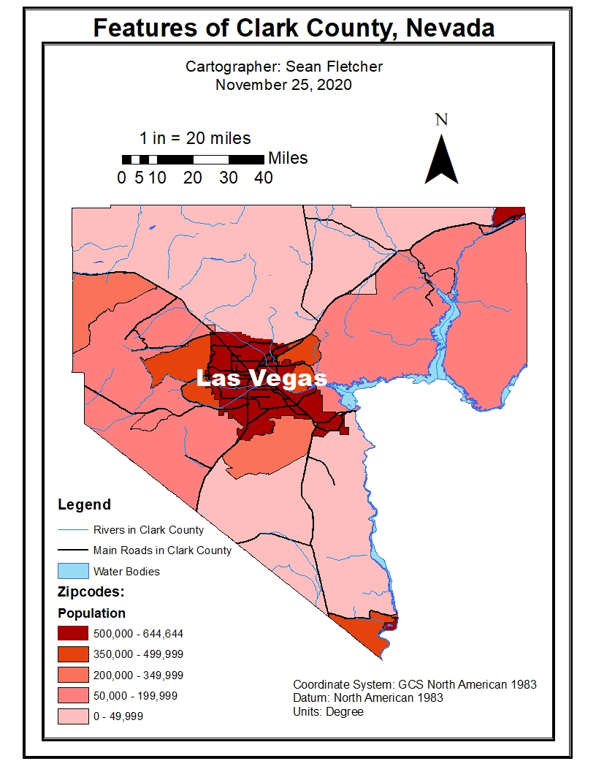
Thematic Map one
Map of the features of Clark County
Shows the population distribution through the area zip codes
City of Las Vegas is the middle map zip code
Stadium should be located within the city due to the high population
No major environmental concerns
All main roads and highways flow through Las Vegas

Slide 9
Getting to my 2nd thematic map
Clip everything
Buffer roads by 1000 feet
Intersect these roads with rivers
Dissolve this layer
Select by attributes for all roads downtown
Create a separate layer for these downtown roads

Slide 10
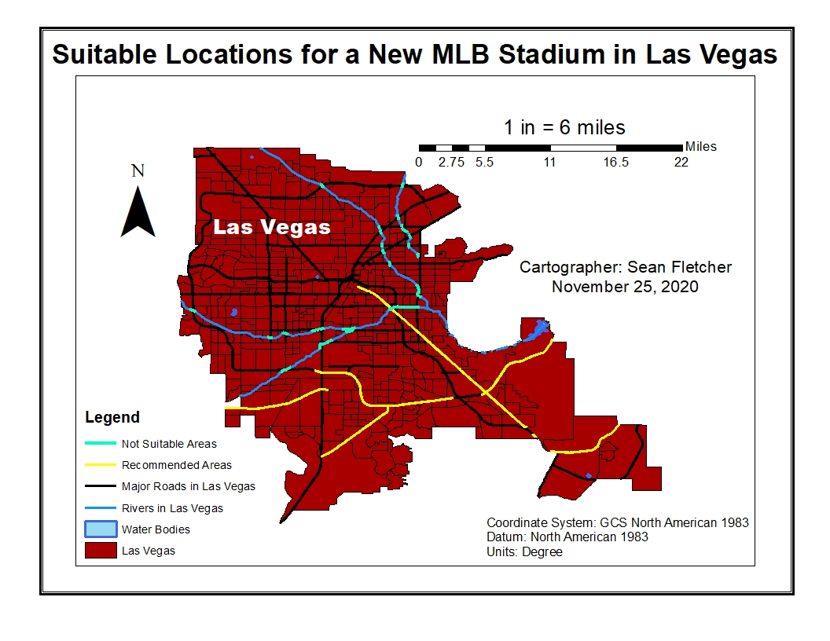

Thematic map two
Suitable Location Sites
Yellow lines are the roads in which a stadium is recommended to be built along
Cyan areas are where roads and rivers intersect – not suitable

Slide 11
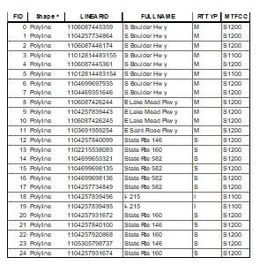
Table
Table is from the recommended areas
Displays all the downtown roads highlighted that would be a good fit for a new MLB stadium
Road names are under “FULL NAME”

Slide 12
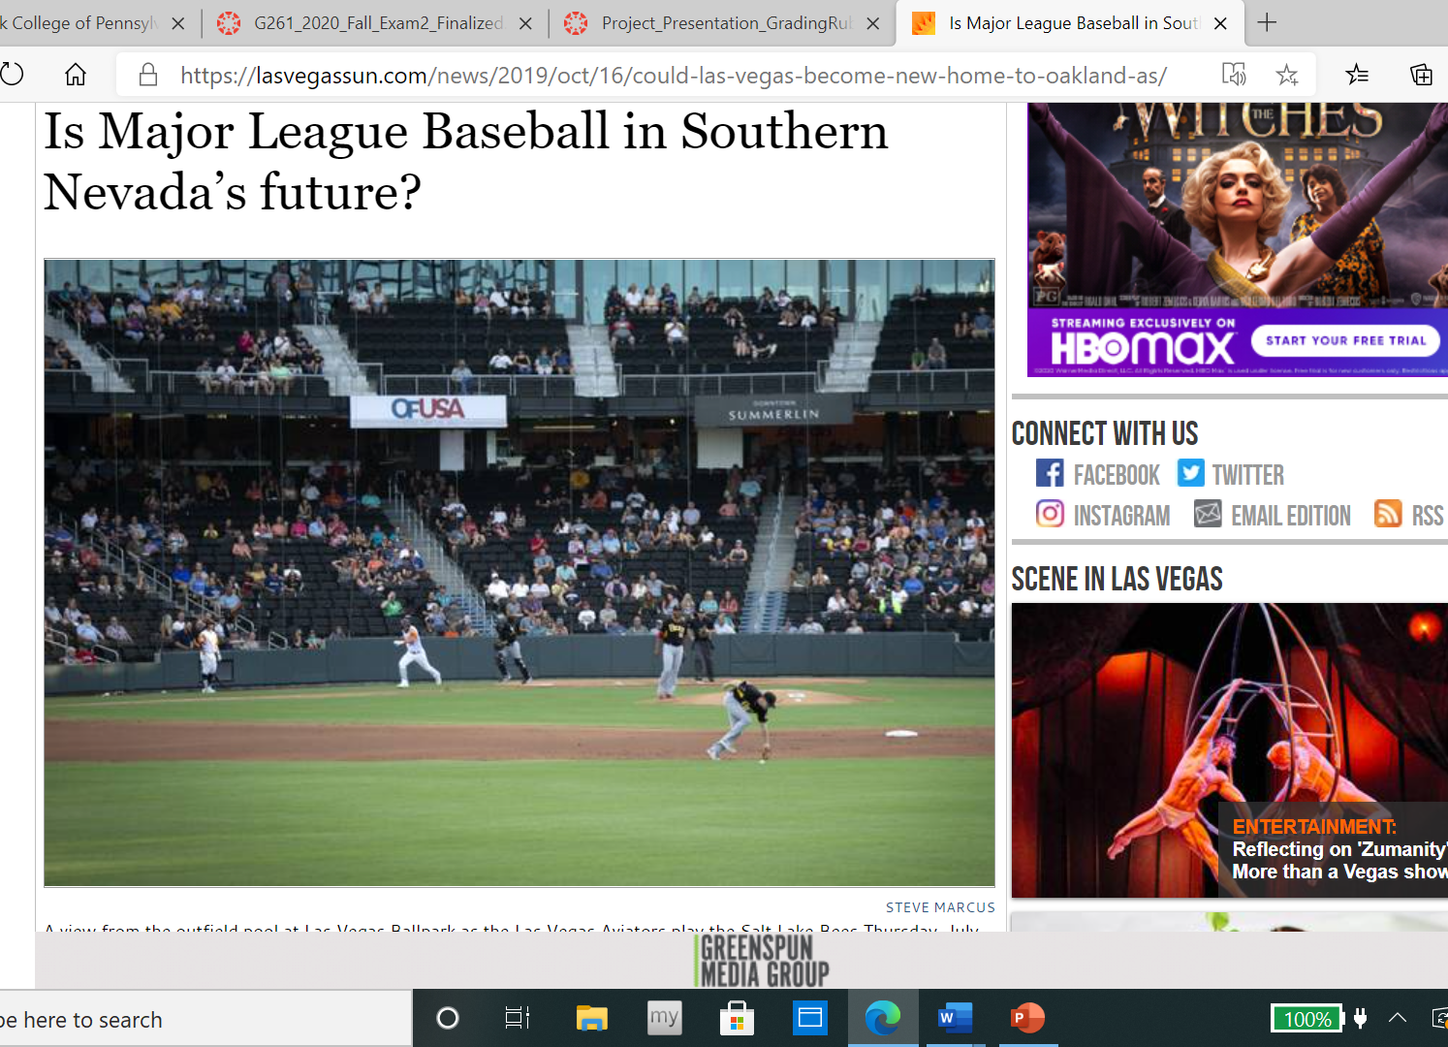
Journal Article Relation
Oakland Athletics could possibly relocate to Las Vegas soon
Las Vegas has a great market for sports teams
NFL and NHL just got teams in Las Vegas
Area is very accessible and there are many spots of undeveloped land.

Slide 13
conclusions
This analysis has shown that if a new MLB stadium were to be built in Las Vegas today it would be recommended that it be built within the downtown areas that are away from rivers and are right by main roads and highways
These areas are also very populated
The maps support both my hypothesis and my thesis statement
The final map of Las Vegas shows that there are multiple areas in the northern and central locations of Las Vegas that are not suitable for a new MLB stadium to be built because of rivers
There is not just one area where a new stadium can be built; from the final map and table there are multiple roads where an MLB stadium can be constructed by
This project analysis could be duplicated to find other areas of other cities for new stadium locations

Slide 14
Bibliography
Bureau, U. (2020, March 12). TIGER/Line Shapefiles. November 30, 2020, from https://www.census.gov/geographies/mapping-files/time-series/geo/tiger-line-file.html
Data Catalog. (n.d.). November 30, 2020, from https://catalog.data.gov/dataset
Horwath, B. (2019, October 16). Is Major League Baseball in Southern Nevada's future? November 30, 2020, from https://lasvegassun.com/news/2019/oct/16/could-las-vegas-become-new-home-to-oakland-as/

