Slide 1

The Spread of Internet Usage Worldwide from 1990 - 2015
By Jack Anderson

Slide 2
Introduction
Research Questions –
  What is the trend in overall internet usage worldwide from 1990 to 2015? What are the probable causes of this trend?
Hypothesis –
  There will be an overall increase in worldwide internet usage. I feel that countries with a GDP higher than 300 Billion will be the countries with the largest increases in internet usage.
Background information –
  The internet was first invented in the 1960s
  In 2018 there was approximately 22 billion devices connected to the Internet of Things.

Slide 3
Data
Since my data covers many countries and twenty-five years of information, it would be rather hard to insert it all into a viewable table, however, I will do my best to explain everything that I am using.
  Internet Usage per 100 Citizens
  Gross Domestic Product (GDP)
    The monetary value of imports to a given country subtracted from the monetary value of exports from the country. A standard way to measure the economic standings of a country.

Slide 4
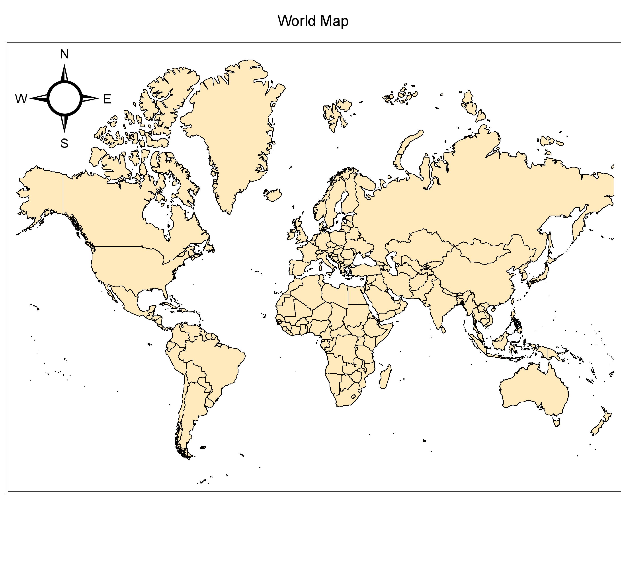
Study Area - Worldwide
The population increased from 5.281 billion in 1990 to 7.341 billion in 2015.
Since I am looking to find a trend in Internet usage worldwide and a possible cause for that trend, I will be using a global area of study.

Slide 5
Mapping and Analysis
Over the next 6 slides we will examine the total internet usage worldwide, try to spot any trends, and then summarize any findings we may come across.

Slide 6
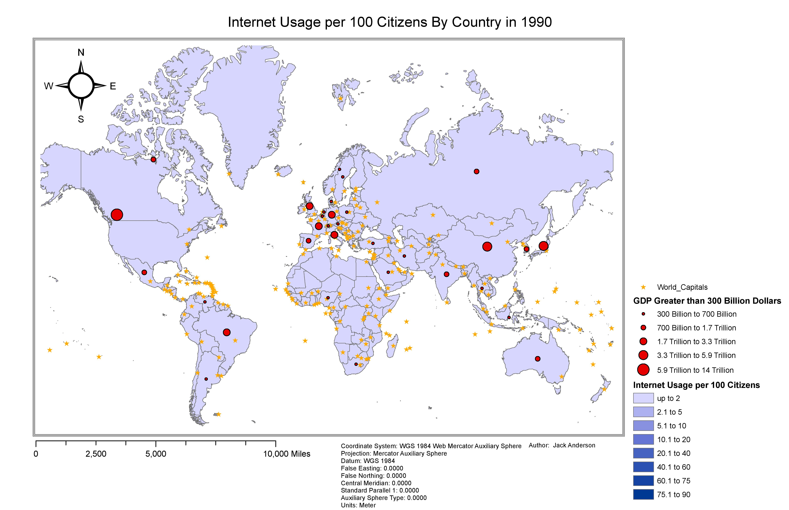

Slide 7
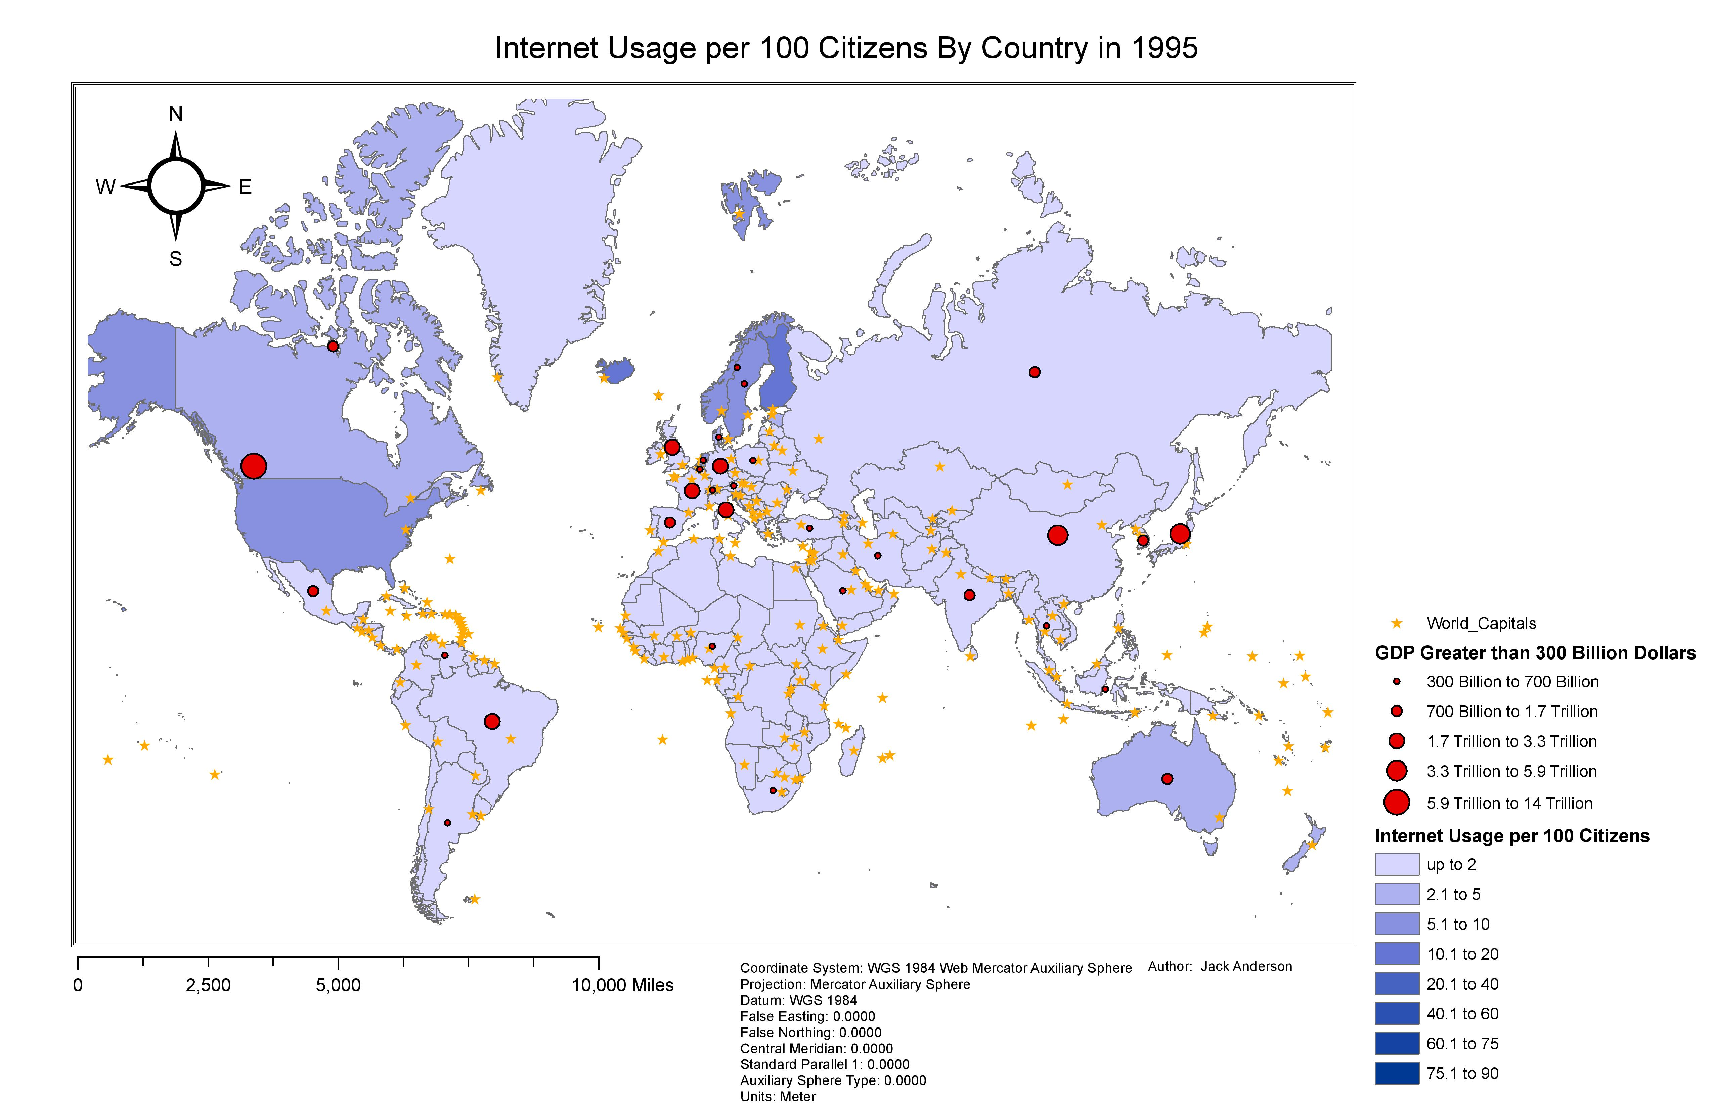

Slide 8
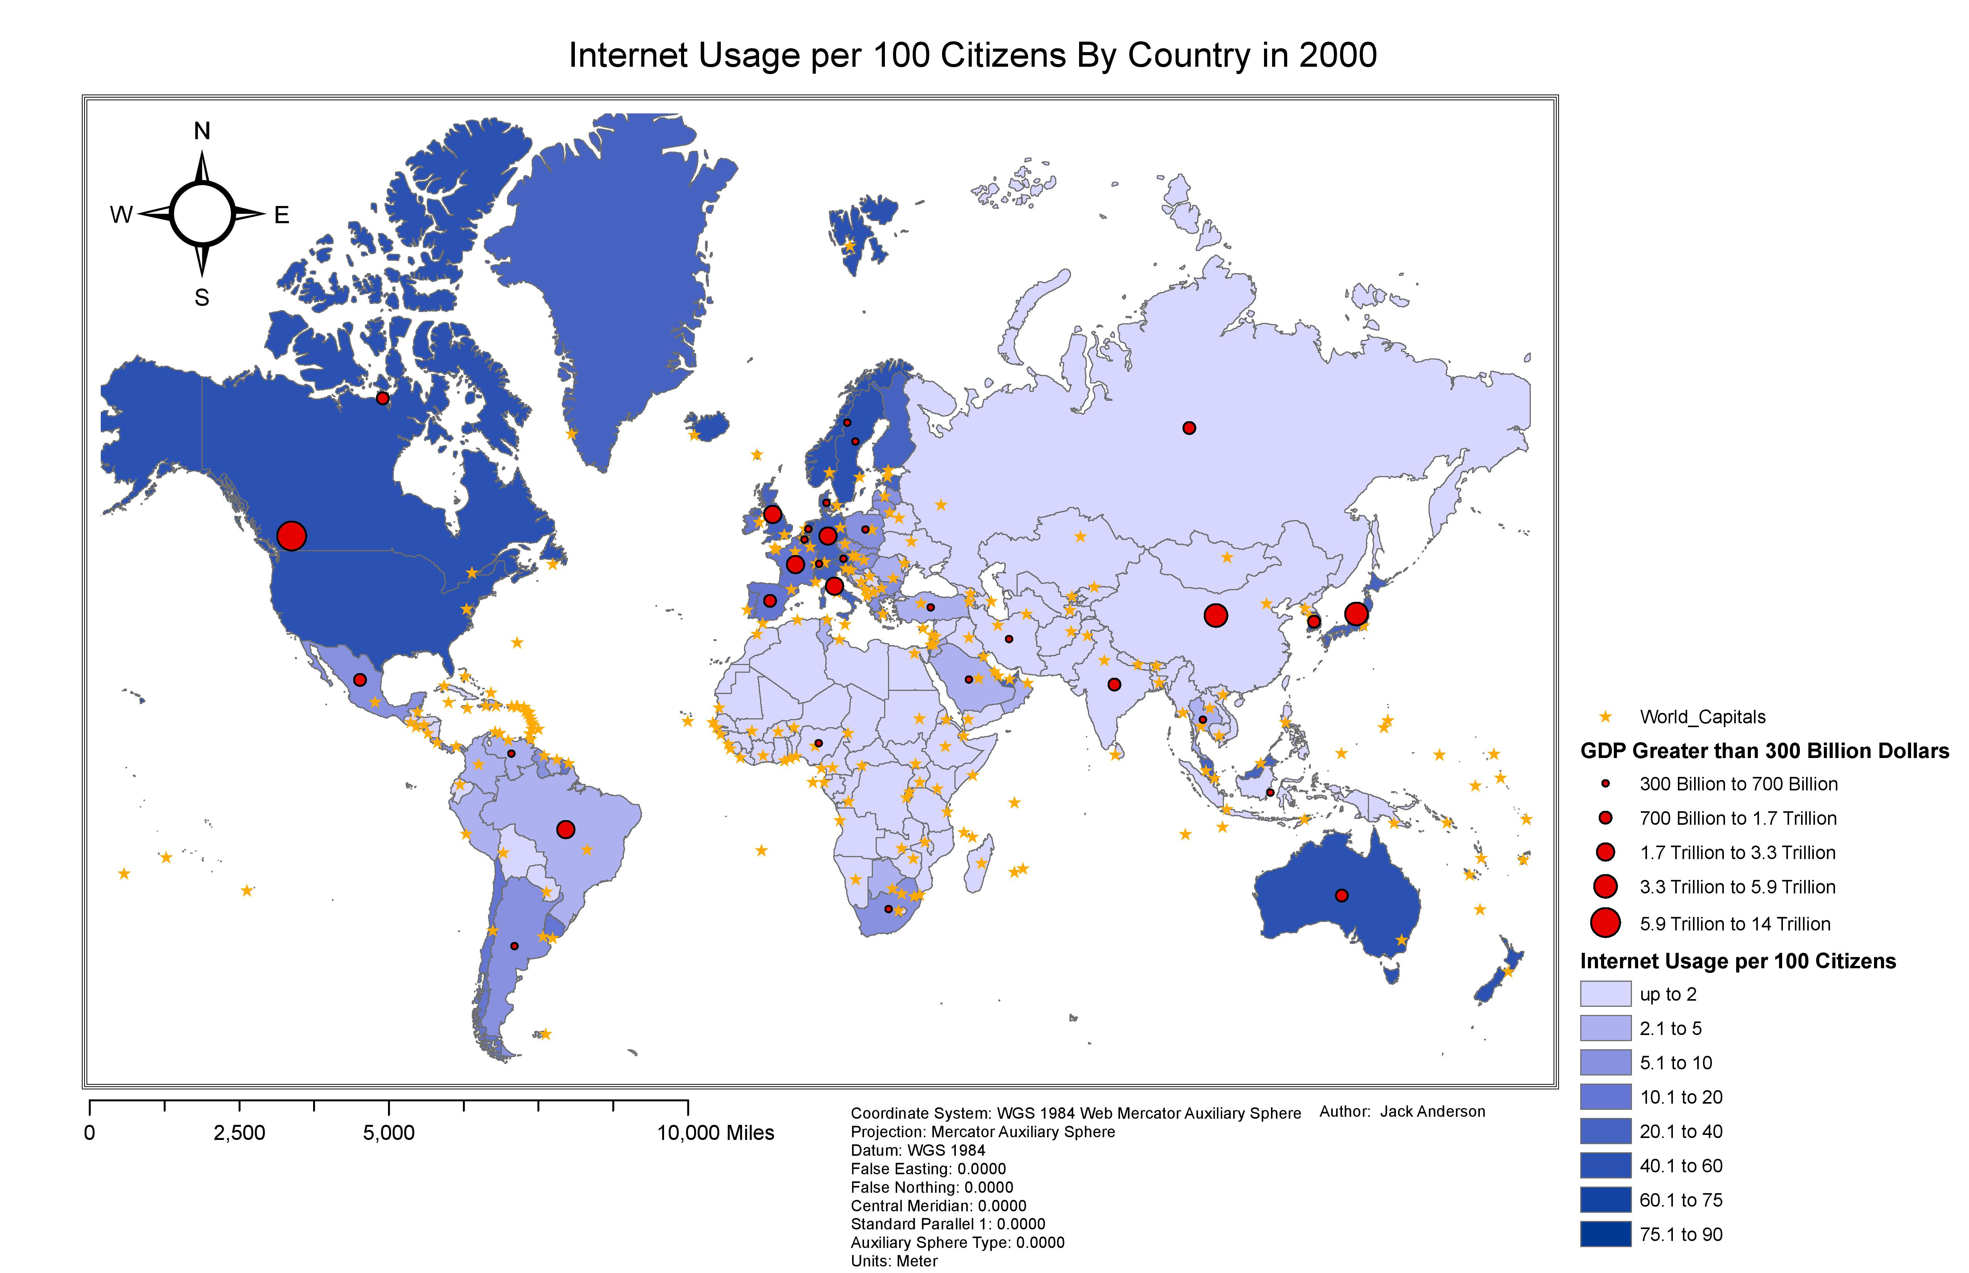

Slide 9
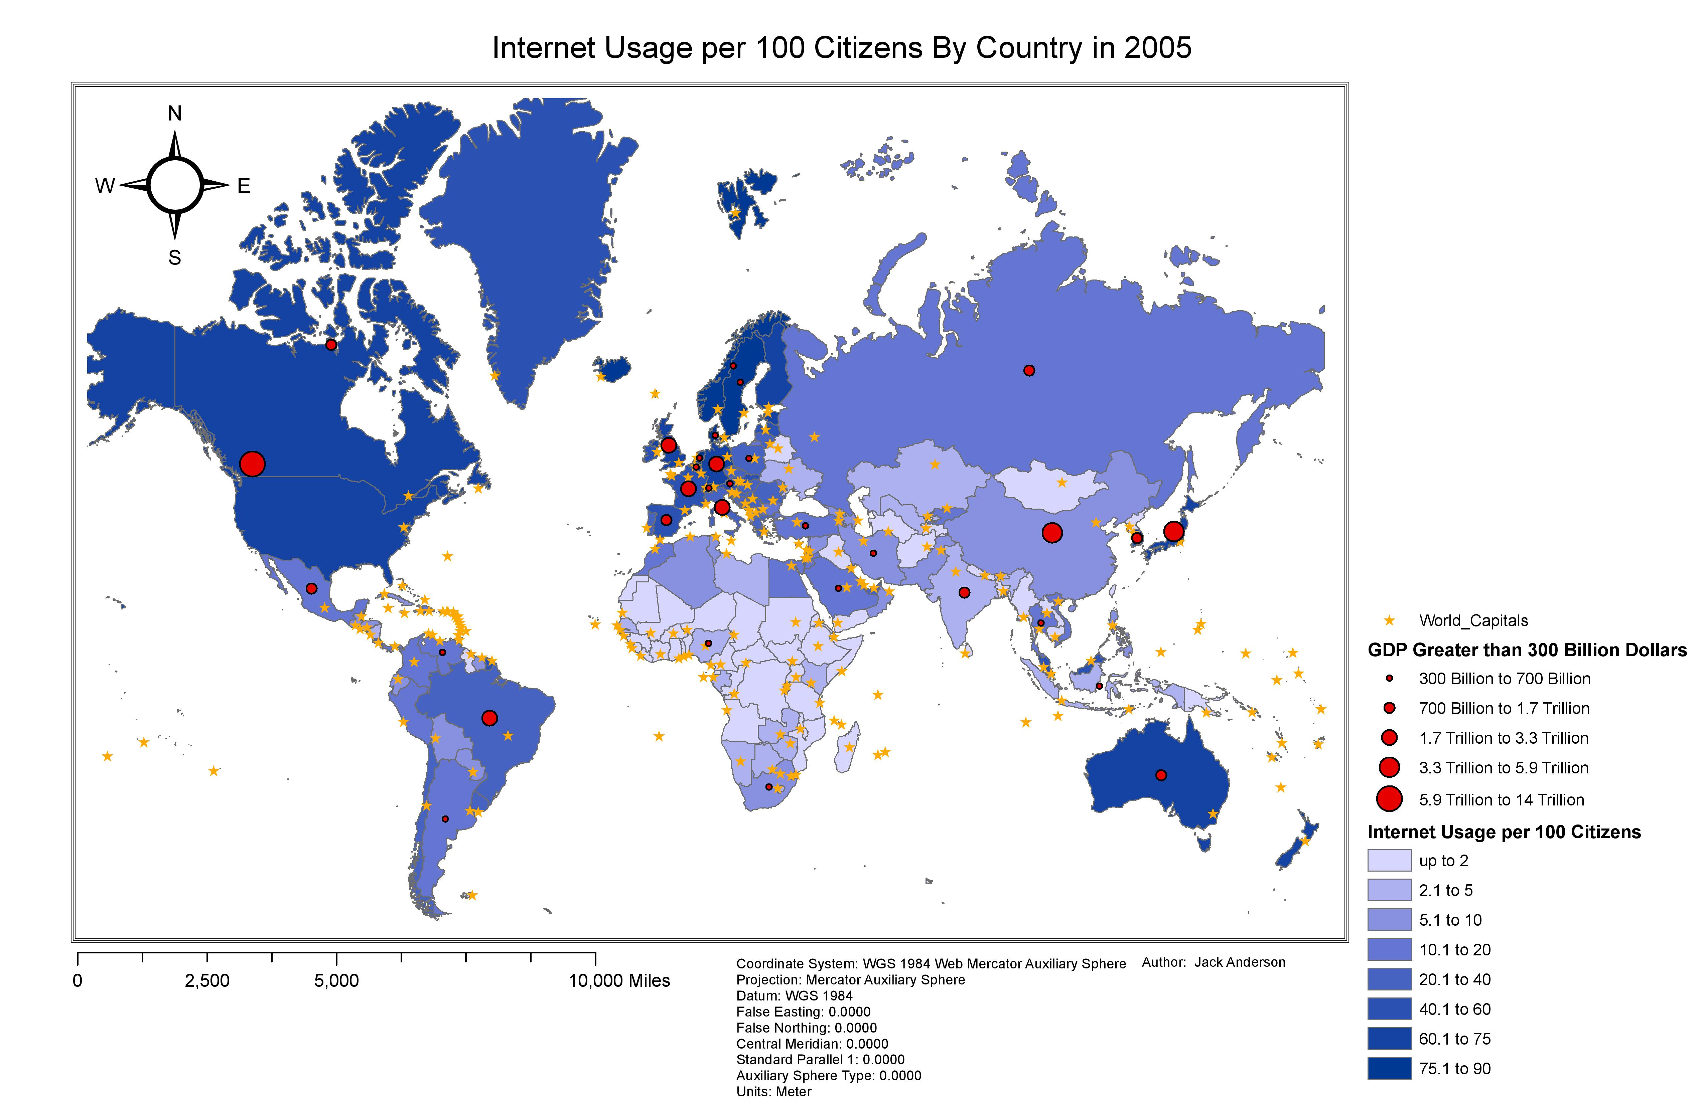

Slide 10
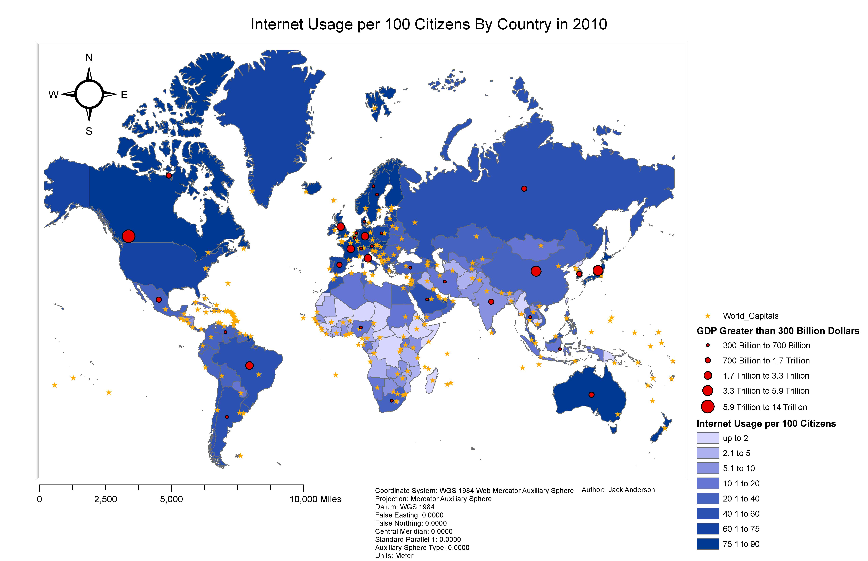

Slide 11
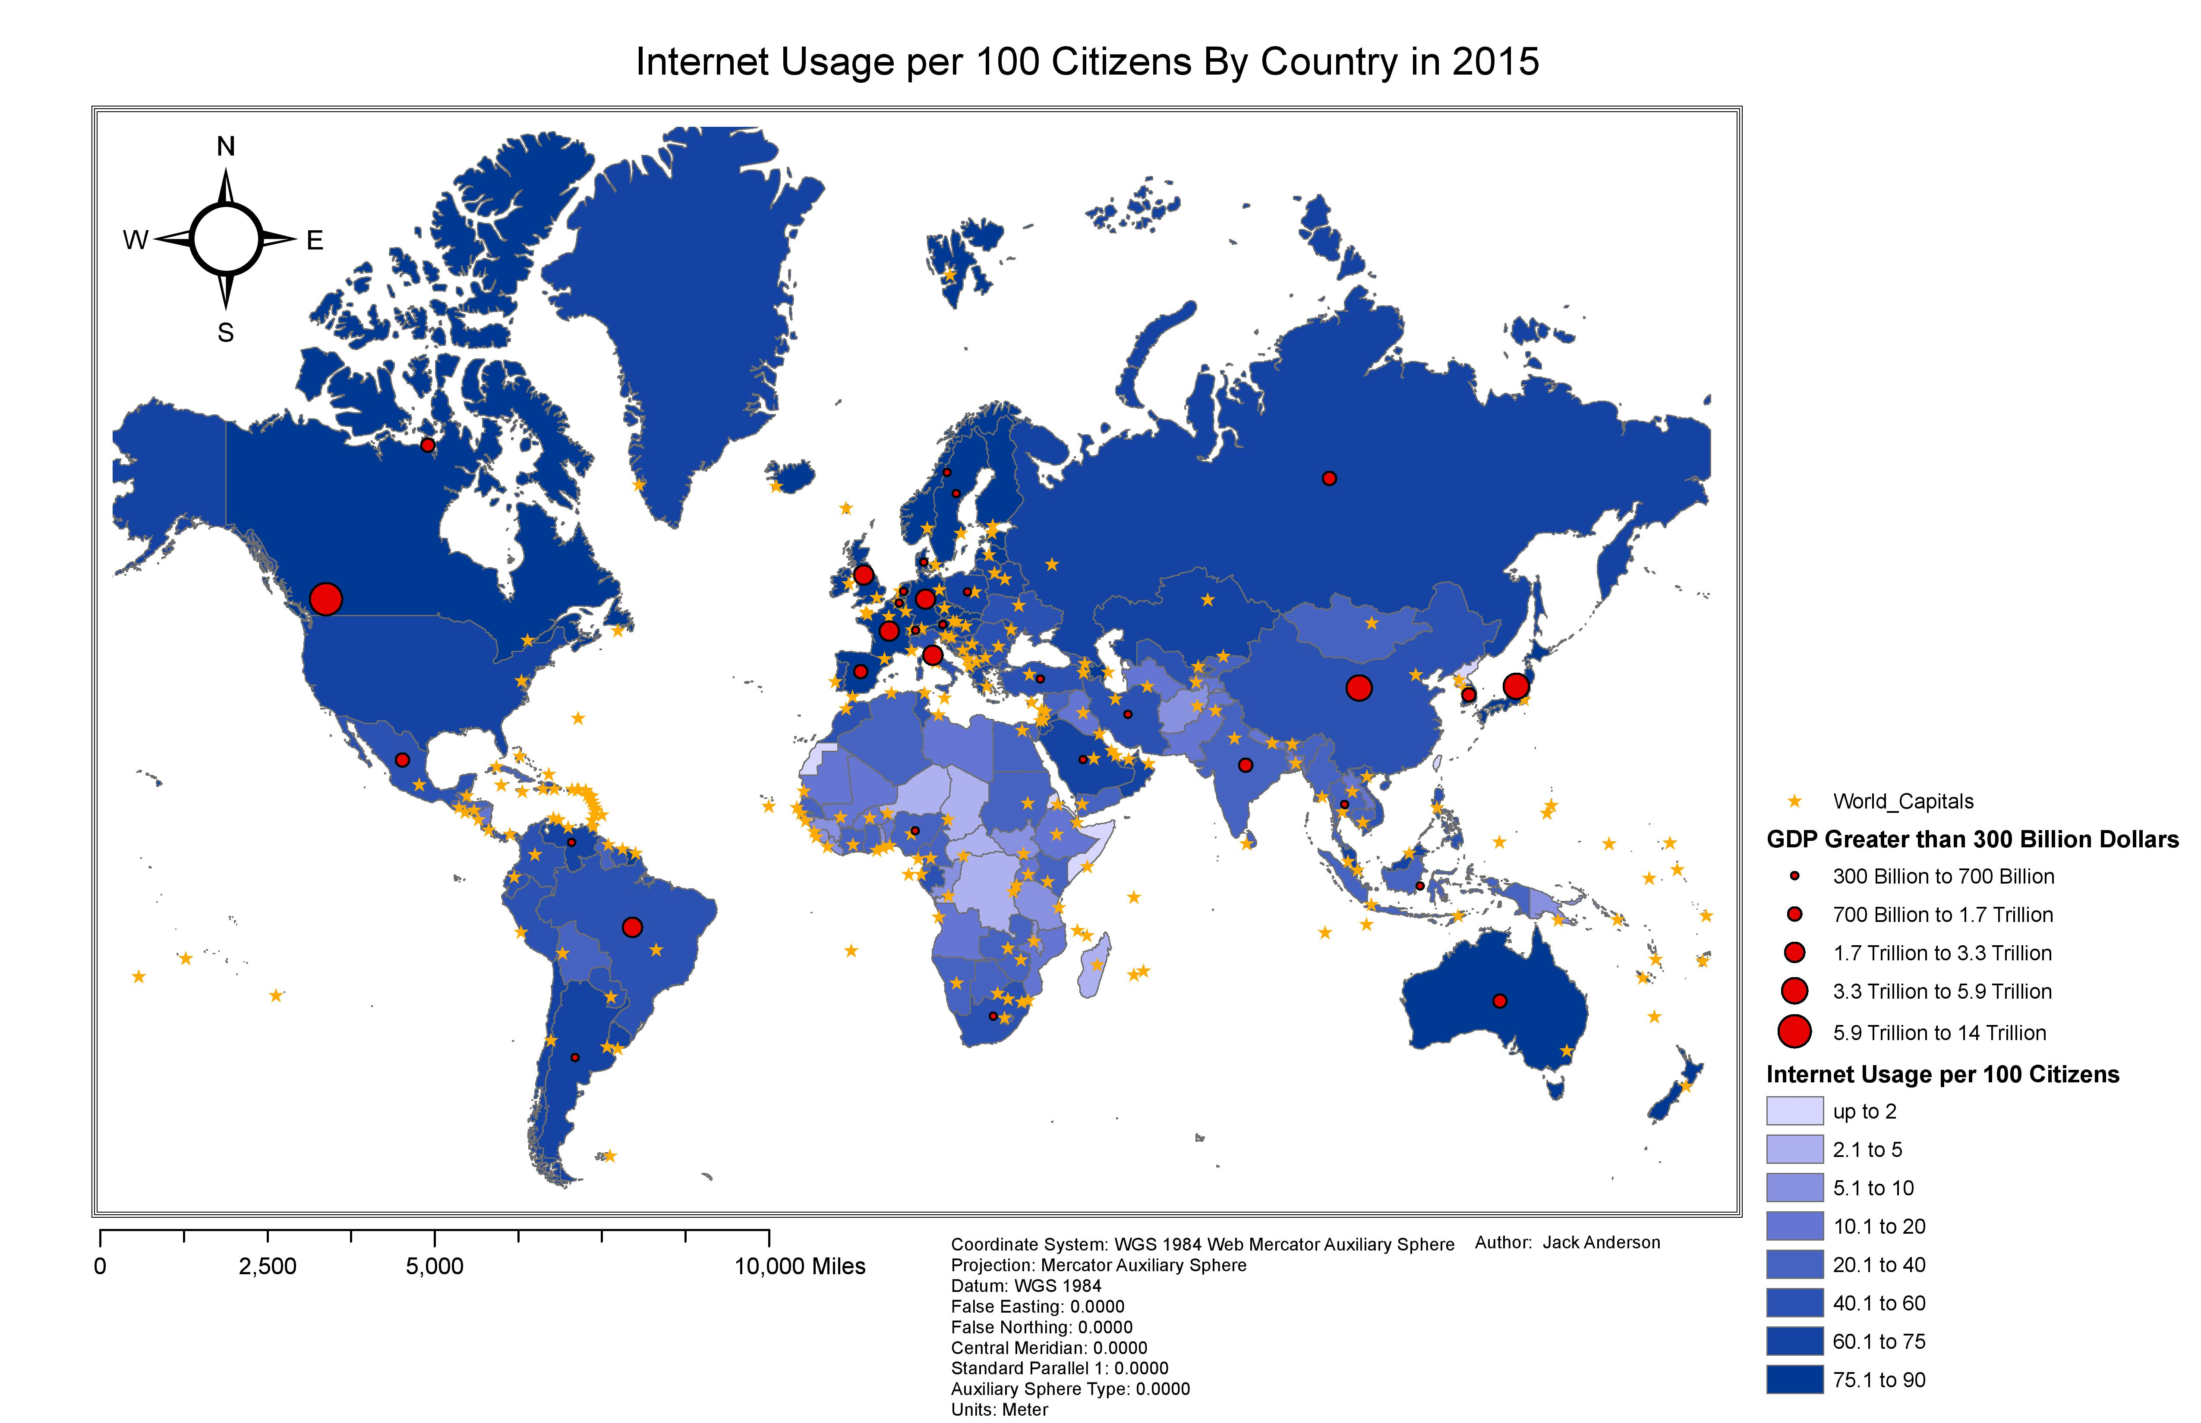

Slide 12
Summary Table
Country Name | GDP in 2016 | Internet Usage Per 100 Citizens in 2015
Argentina | 3.68736E+11 | 68.0431
Australia | 1.14179E+12 | 84.5605
Austria | 3.7768E+11 | 83.9401
Belgium | 4.71151E+11 | 85.0529
Brazil | 2.14304E+12 | 58.328
Canada | 1.57704E+12 | 88.47
China | 5.93053E+12 | 50.3
Denmark | 3.13176E+11 | 96.3305
France | 2.56504E+12 | 84.6945
Germany | 3.30444E+12 | 87.5898
India | 1.70845E+12 | 26
Indonesia | 7.09191E+11 | 21.9761
Iran | 4.22568E+11 | 45.335
Italy | 2.05536E+12 | 58.1417
Japan | 5.49538E+12 | 91.058
Mexico | 1.04737E+12 | 57.431
Netherlands | 7.77158E+11 | 91.7241
Nigeria | 3.66351E+11 | 24.5
Norway | 4.21236E+11 | 96.8103
Poland | 4.69737E+11 | 67.997
Russia | 1.52492E+12 | 73.41
Saudi Arabia | 5.26811E+11 | 69.6162
South Africa | 3.63241E+11 | 51.9191
South Korea | 1.01489E+12 | 89.6486
Spain | 1.38484E+12 | 78.6896
Sweden | 4.62903E+11 | 90.6102
Switzerland | 5.50639E+11 | 87.4791
Thailand | 3.18908E+11 | 39.3161
Turkey | 7.31144E+11 | 53.745
United Kingdom | 2.28556E+12 | 92.0003
United States | 1.49583E+13 | 74.554202
Venezuela | 3.93808E+11 | 61.8692

Slide 13
Top 5 GDP Countries
Country Name | GDP in 2016 | Internet Usage Per 100 Citizens in 2015
United States | 1.49583E+13 | 74.554202
China | 5.93053E+12 | 50.3
Japan | 5.49538E+12 | 91.058
Germany | 3.30444E+12 | 87.5898
France | 2.56504E+12 | 84.6945

Slide 14
Top 5 Internet Usage Countries
Country Name | GDP in 2016 | Internet Usage Per 100 Citizens in 2015
Norway | 4.21236E+11 | 96.8103
Denmark | 3.13176E+11 | 96.3305
United Kingdom | 2.28556E+12 | 92.0003
Netherlands | 7.77158E+11 | 91.7241
Japan | 5.49538E+12 | 91.058

Slide 15
Analysis
From the previous two tables, the only country in both was Japan. So while there may not be a direct correlation from GDP to Internet Usage, the majority of the 32 countries that are above 300 Billion dollars in GDP are in the 75.1 to 90 or above range.

Slide 16
Academic Article Connections
In Rye’s Negotiating the Symbolic Power of Information and Communication Technologies (ICT): The Spread of Internet-Supported Distance Education he claims that the spread of internet is deeply connected to higher education. He also states that the diffusion of internet worldwide is a symbol of “modernization and progress.”
In Hargittai’s Weaving the Western Web: explaining differences in Internet connectivity among OECD countries, we see that “general economic strength does not matter in predicting Internet connectivity” within a country. They find that if governments want to stay on top of new information related to the economy and other topics that they may need to consider strengthening their Internet policies.

Slide 17
Conclusion
There may be some correlation between GDP and Internet usage, but according to the academic research it appears that there may be more of a sociological reason to internet spread rather than a purely empirical based reason.
If I were to continue my research into an empirical reason as to which countries have the greatest Internet increase, I would look at population growth as well as the overall education levels of the countries.

Slide 18
Bibliography
Hargittai, E. (1999). Weaving the Western Web: Explaining differences in Internet connectivity among OECD countries. Telecommunications Policy, 23(10-11), 701-718. Retrieved November 30, 2020.
Rye, S. (2009). Negotiating the Symbolic Power of Information and Communication Technologies (ICT): The Spread of Internet-Supported Distance Education. Information Technology for Development, 15(1), 17-31. doi:10.1002/itdj

