Slide 1
Food Deserts and Crime in Colorado
By: Zachary Ronayne

Slide 2
Background and Research questions
Food deserts are locations with a lack of access to super markets
Available food is often unhealthy
Generally located in poverty stricken areas
Do food deserts correlate with crime rates?
Hypothesis: more severe food deserts have more crime

Slide 3
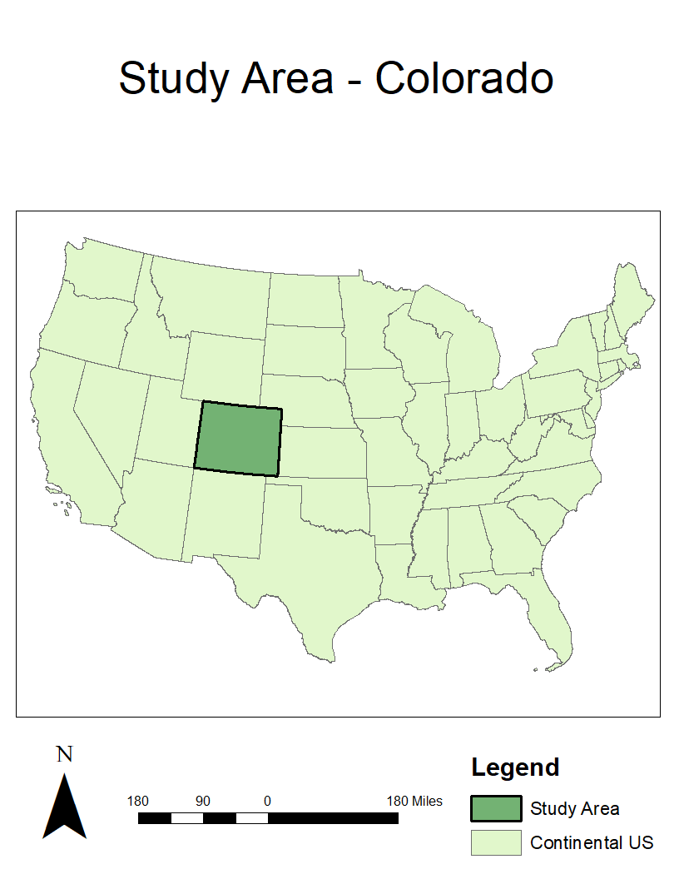
Study Area
State of Colorado
Analyzed based on individual counties and by centroids
Population: 5,758,736
Poverty rate: 9.3%
Per capita income in 12 months: $34,415
Location: Southwest of USA
Physical geography: Mountainous with some plains and rivers
Climate: Cold and dry

Slide 4
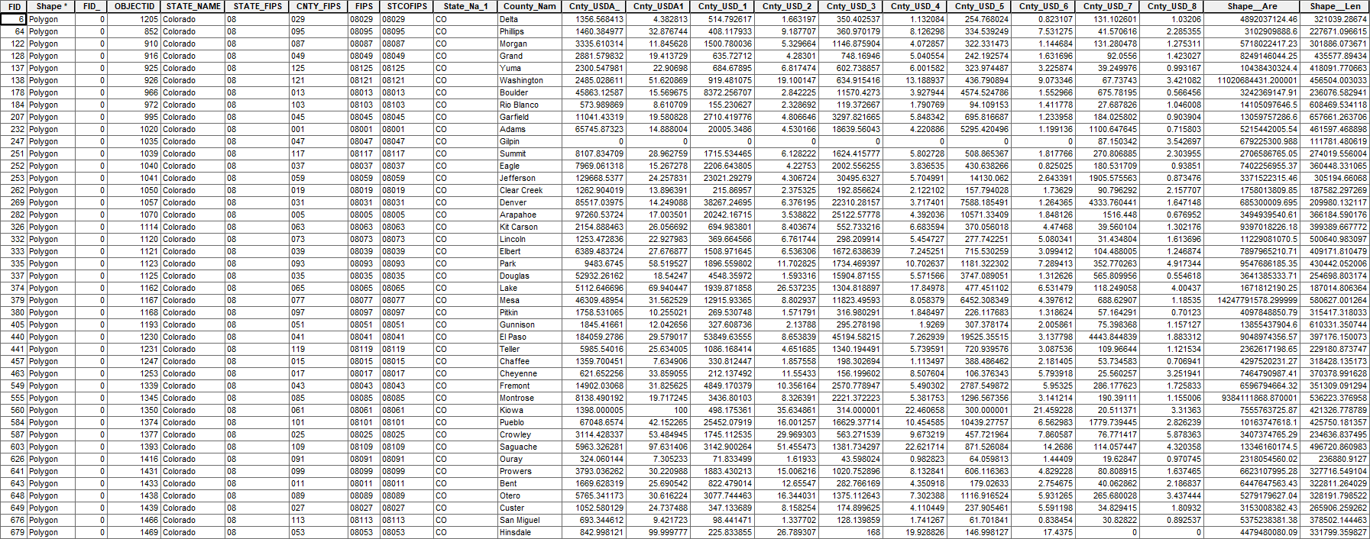
Data – Food Desert Ratings
This is a subset of all data

Slide 5
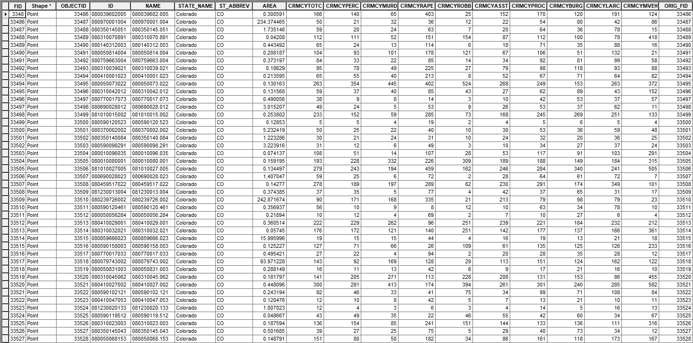
Data – Crime Rates
This is a subset of all data

Slide 6
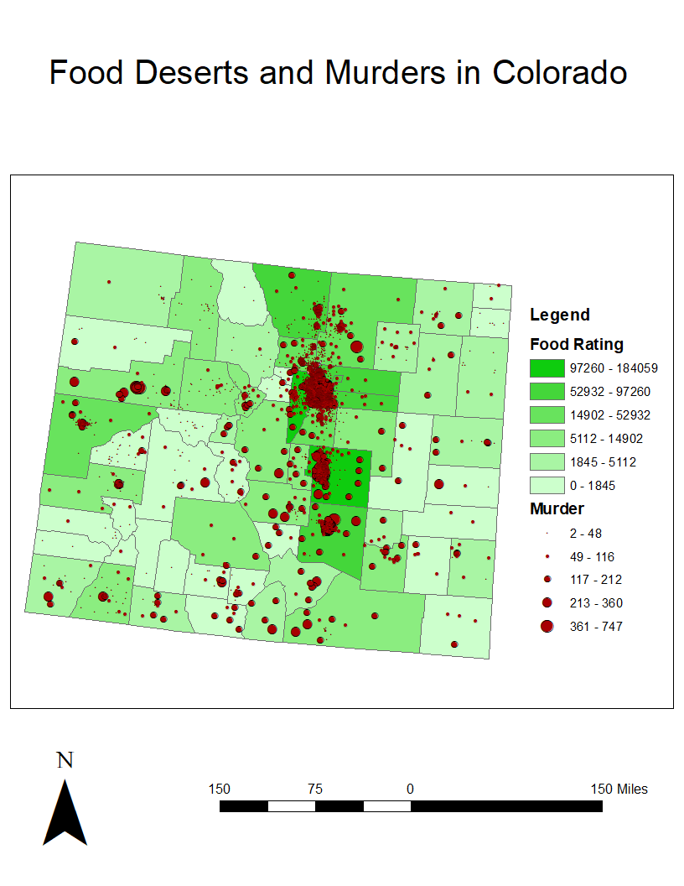

Slide 7
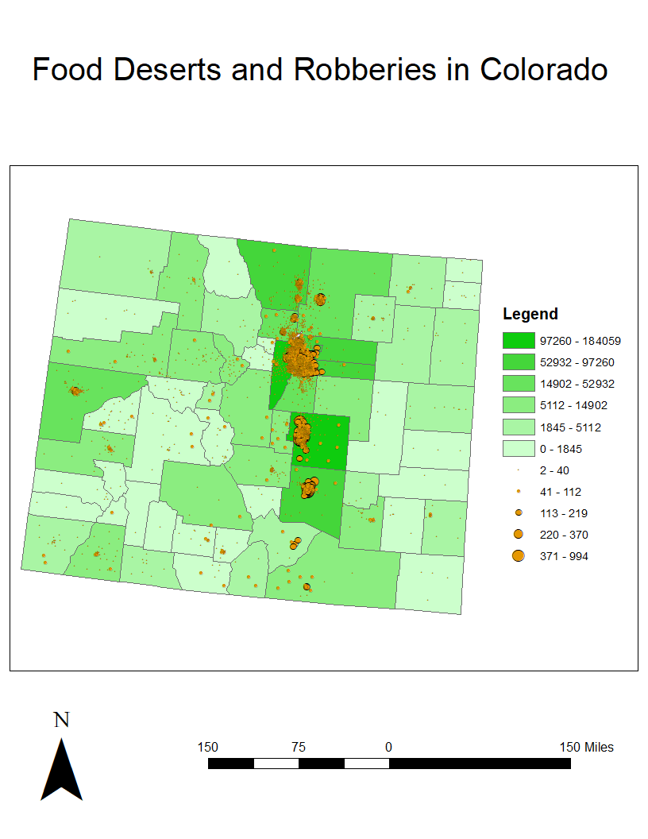

Slide 8
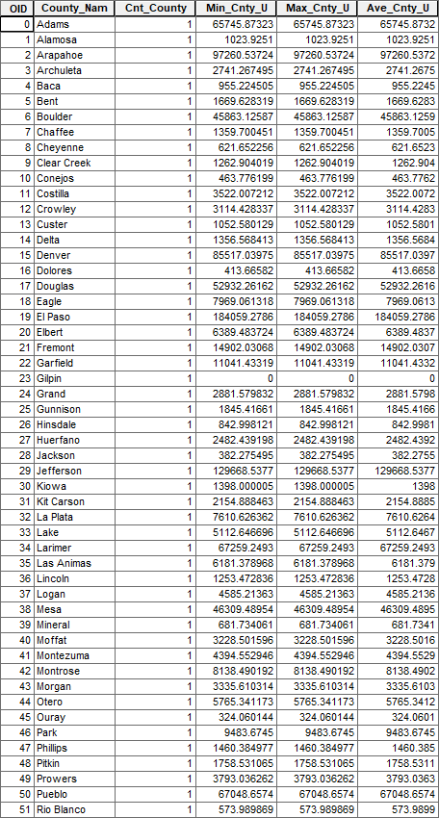
Summary Table – Food Deserts

Slide 9
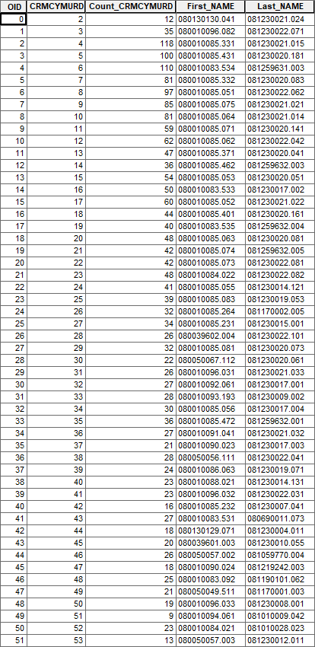
Summary Table – Murder Rates

Slide 10
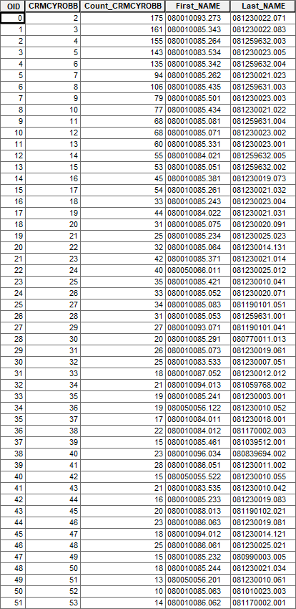
Summary Table – Robbery Rates

Slide 11
Conclusion
Hypothesis was incorrect, the opposite occurred
There is a strong correlation between crime and food deserts

Slide 12
Bibliography
United States Census Bureau. (2019). QuickFacts Colorado. United States Census Bureau. https://www.census.gov/quickfacts/CO
Block, J. P., & Subramanian, S. V. (2015). Moving beyond "food deserts": reorienting United States policies to reduce disparities in diet quality. PLoS Medicine, 12(12). https://link.gale.com/apps/doc/A451530832/OVIC?u=ycp_main&sid=OVIC&xid=877ad752
Tomerlin, B. (2005). Stretching liability too far: Colorado's felony murder statute in light of auman. Denver University Law Review, 83(2), 639-664.

